Slide 1
Fintech Project: FX Market Analysis
By: Larry Gagnon, Ganna Kassantini, Kainat Ahmed, and Jassy Badwal

Slide 2
Purpose
Showcasing FX currency market and comparing it to other global markets, focusing on trends and analysis.
Pinpointing critical data sets to indicate market volatility/fluctuation and their correlation to current and past FX rates.
Valuable asset for importers and exporters in goods/services industry for FX risk management strategies.
Beneficial for day-traders in the FX markets and users making/sending international payments

Slide 3
Technical goals
Task 1
Task 2
Task 3
Use an API to collect today’s FX rates for Canada, data for gold, India, Brazil, Norway, USA( S&P and Dow).
Create an interactive world map that shows today’s FX rates for the Canadian dollar compared to other countries around the world.
Get correlation heatmaps for market fluctuations and FX rates. Use PyViz, GeoViews, and Hvplot to create six to eight data visualizations

Slide 4
API location
Data cleaning
Live and historical API data was taken from Historical Prices and Fundamental Financial Data API (eodhistoricaldata.com) 70+ stock exchanges all over the world, 30 year historical data
Challenge 1
Pandas code used to pull EoD Historical Data specific to Major Market Indices around the world. The data is filtered to the 'close' column and Nulls are dropped. The time period of the data collected is 10 years.

Slide 5
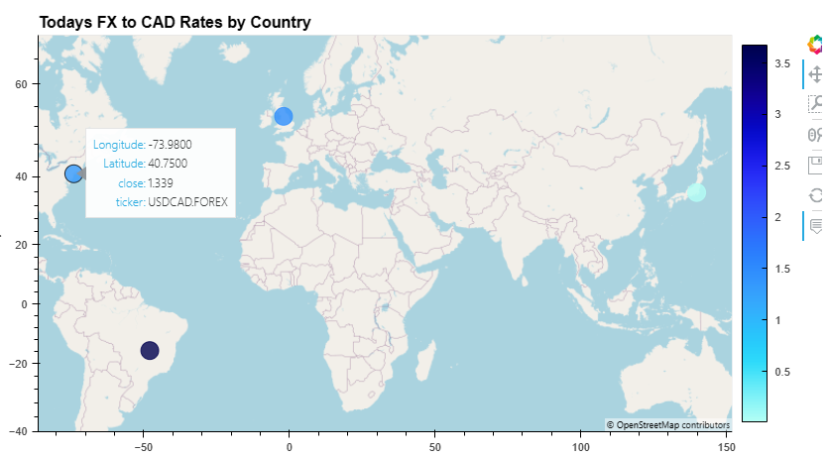
Mapping
We used geoviews to create map, adding longitude and latitude to pinpoint the location of the major currency pairs.
Challenge 1

Slide 6
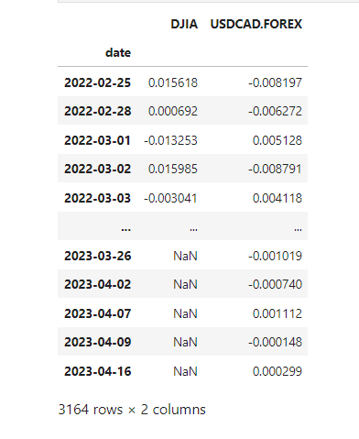
Correlation of USD/CAD FX to Dow Jones Index
DJIA and USD/CAD have shown different patterns of daily fluctuations.
DJIA has higher volatility than USD/CAD.
There is some degree of inverse (negative) correlation between DJIA and USD/CAD.
On days with positive change in DJIA, USD/CAD generally exhibited negative change and vice versa.
Many factors can affect the performance of these two markets.

Slide 7
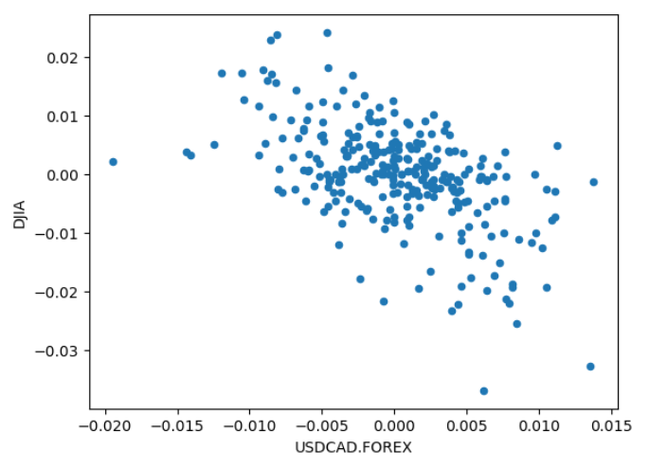
Scatter plot
USD/CAD and DJIA
Positive correlation: clear pattern in scatter plot, points cluster together in a linear or curved shape, trending upward.
Negative correlation: clear pattern in scatter plot, points cluster together in a linear or curved shape, trending downward.
No correlation: random distribution of points in scatter plot, no clear pattern or trend.
Result: Strong Negative Correlation

Slide 8
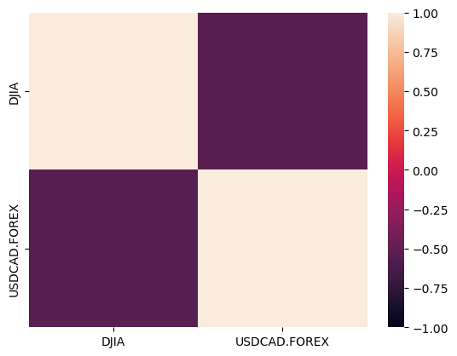
Heatmap & Correlation We used correlation function and seaborn library to create heatmaps.
USD/CAD and DJIA
Challenge 1
Strong positive correlation: heatmap shows region of brighter colors
Strong negative correlation: heatmap shows region of darker colors
Result: Strong Negative Correlation (- 0.50 color range)

Slide 9
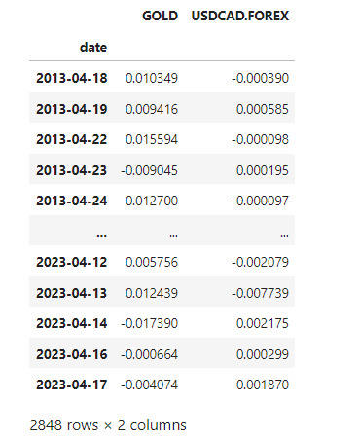
Correlation of USD/CAD FX to Gold
Gold and USD/CAD have experienced gains and losses over the past 10 years.
Gold has more significant fluctuations in daily returns, ranging from over 5% gains to over 4% losses
USD/CAD has smaller fluctuations in daily returns, generally ranging between 1-2%
The two assets have a negative correlation, with gains in one leading to losses in the other
Correlation is not always significant, and both assets have experienced gains or losses on the same day.
Daily returns are affected by various factors, such as economic conditions and political events.
Caution when making investment decisions.

Slide 10
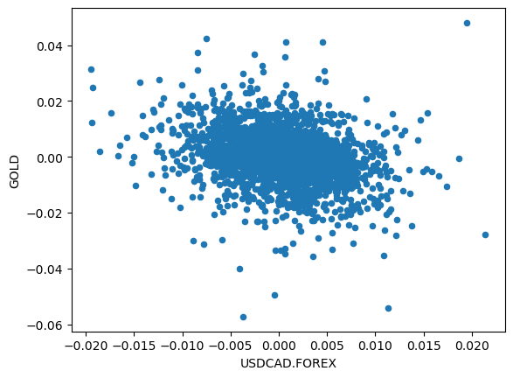
Scatter plot
USD/CAD and Gold
Challenge 1
Downward sloping trend indicates as one asset's daily returns increase, the other asset's daily returns tend to decrease.
Weak or non-existent correlation: scatter of points with no clear trend.
Based on the data, we expect to see a slight downward sloping trend in the scatterplot, indicating a weak negative correlation.

Slide 11
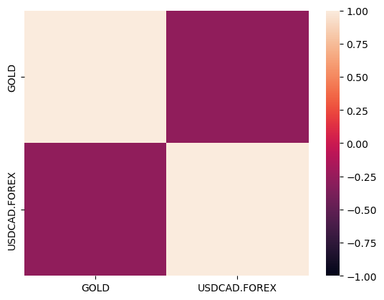
Heatmap
USD/CAD and Gold
Challenge 1
Result: Weak Negative Correlation (- 0.25 color range)

Slide 12
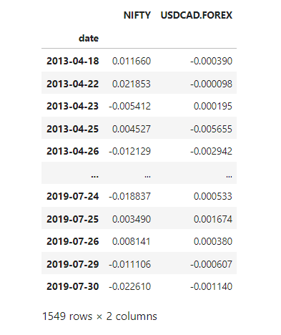
Correlation of USD/CAD FX to India Index
Returns of NIFTY and USD/CAD have different magnitudes and signs on most trading days.
This indicates that the two assets are not strongly correlated.
Correlation refers to the extent to which two assets move together.
Weak or non-existent correlation suggests that the returns of one asset do not significantly influence the returns of the other.

Slide 13
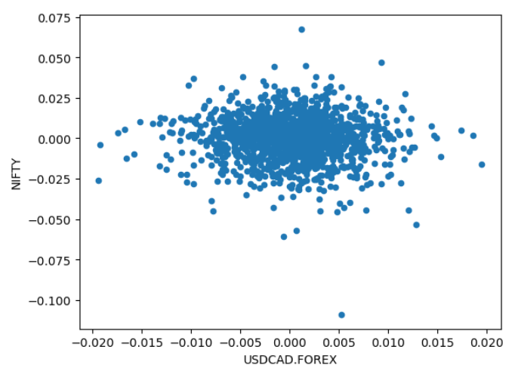
Scatter plot
USD/CAD and NIFTY
Challenge 1
Scatter plot shows random distribution of points with no clear pattern or trend.
Indicates no correlation between the two assets.
Central, Flat

Slide 14
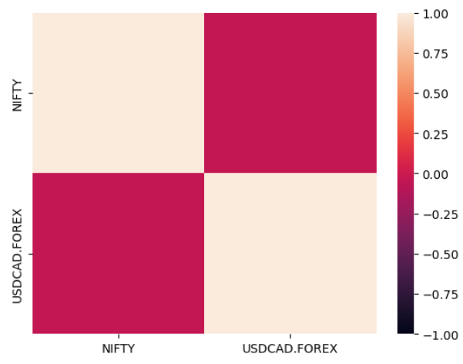
Heatmap
USD/CAD and NIFTY
Challenge 1
The heatmap color scheme shows the degree of correlation between two assets.
Near-zero correlation suggests that there is no significant relationship.
Non-existent correlation (0.00 color range)

Slide 15
Impact
max growth

